Slide 1
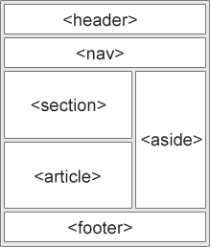
HTML Semantic Elements
Websites often display content in multiple columns (like a magazine or newspaper).
HTML offers several semantic elements that define the different parts of a web page:

Slide 2
HTML Layout Elements
<header> tag:
The header tag contains information related to the title and heading of the related content.
The <header> element is intended to usually contain the section’s heading (an h1-h6 element)
The <header> element can also be used to wrap a section’s table of contents, a search form, or any relevant logos.
The <header> tag is a new tag in HTML5 and it requires a starting tag as well as an end tag.
There can be several <header> elements in one document.
A <header> tag cannot be placed within a <footer>, <address> or another <header> element.

Slide 3
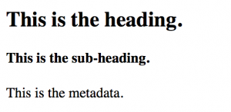
HTML Layout Elements
<html>
<head>
<title>Header Tag</title>
</head>
<body>
<article>
<header>
<h1>This is the heading.</h1>
<h4>This is the sub-heading.</h4>
<p>This is the metadata.</p>
</header>
</article>
</body>
</html>

Slide 4
HTML Layout Elements
<nav> tag:
The <nav> tag is a new element in HTML5.
It is used to define a block of navigation links, either within the current document or to other documents.
One HTML document may contain several <nav> tags.
For example, one for site navigation and one for intra-page navigation.

Slide 5

HTML Layout Elements
<nav> tag:
The <nav> tag comes in pairs, the content is written between the opening (<nav>) and closing (</nav>) tags.
Ex:
<nav>
<a href="/learn-html.html">HTML</a> | <a href="/learn-css.html">CSS</a> | <a href="/learn-javascript.html">JavaScript</a> | <a href="/learn-php.html">PHP</a> |
</nav>

Slide 6
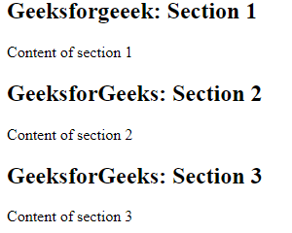
HTML Layout Elements
<section> tag:
Section tag defines the section of documents such as chapters, headers, footers or any other sections.
The section tag divides the content into section and subsections.
Ex:
<section>
<h1>Geeksforgeeek: Section 1</h1>
<p>Content of section 1</p>
</section>
<section>
<h1>GeeksforGeeks: Section 2</h1>
<p>Content of section 2</p>
</section>

Slide 7
HTML Layout Elements
<article> tag:
The <article> tag is one of the new sectioning element in HTML5.
The HTML <article> tag is used to represent an article.
The article element represents a component of a page that consists of self-contained composition in a document, page or a site.

Slide 8
<article> tag:
Ex:
<body>
<article style="width: 300px; border: 2px solid gray; padding: 10px; border-radius: 10px; margin:5px;“>
<img src="https://media.geeksforgeeks.org/wp-content/cdn-uploads/20190710102234/download3.png alt="" width="300" height="250“ class="alignnone size-medium wp-image-560930" />
<h1> GeeksforGeeks</h1>
<p>Sandeep Jain(FOUNDER) An IIT Roorkee alumnus and founder
of GeeksforGeeks. Apart from GeeksforGeeks, he has worked
with DE Shaw and Co. as a software developer and JIIT Noida
as an assistant professor.</p>
</article> </body>

Slide 9
<aside> tag
Defines content aside from the content (like a sidebar)
The <aside> tag contains mainly author information, links, related content and so on.
<aside> Vs <div>: Both tags have same behavior with different meaning.
<div >: It define or create division or section in the web page.
<aside>: It does the same job by creating section or division but it conntains only the content that is related to the main web page.

Slide 10
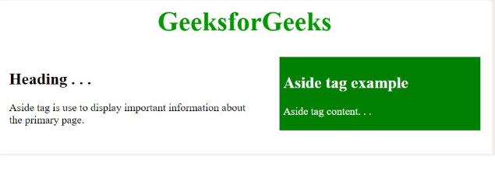
<aside> tag Ex
<style>
aside {
float:right; width: 40%;
float: right;
background- color: green;
color: white;
padding:5px;
margin:10px;
height:100px ; }
</style>
<aside>
h1>Aside tag example</h1>
<p>Aside tag content.</p>
</aside>

Slide 11
<footer >tag
The <footer> tag in HTML is used to define a footer of HTML document.
This section contains the footer information (author information, copyright information, carriers, etc).
The footer tag is used within the body tag. The <footer> tag is new in the HTML5.
The footer elements require a start tag as well as an end tag.

Slide 12
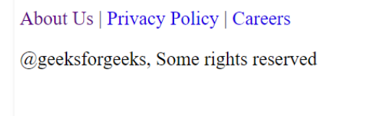
<footer >tag Ex:
<body>
<footer>
<nav>
<p>
<a href=
"https://www.geeksforgeeks.org/about/">About Us</a>|
<a href=
"https://www.geeksforgeeks.org/privacy-policy/">Privacy Policy</a>|
<a href=
"https://www.geeksforgeeks.org/careers/">Careers</a>
</p>
</nav>
<p>@geeksforgeeks, Some rights reserved</p>
</footer>
</body>

